Slide 1
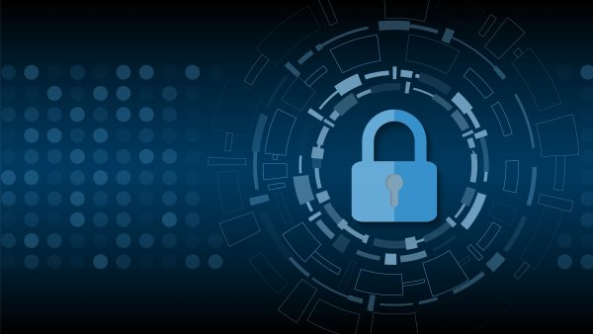

The Suffering Attack
Using ultrasonic waves to hack cell-phones
CPR101 NGG: Presentation
Prof. Tim Mckenna
Presented by Jonathan Glick
013972062
Seneca College - March 23, 2020
Notes:
Welcome to Jonathan Glick’s CPR101’s presentation called
The Suffering attack, using ultrasonic waves to hack cellphones
I obtained this article on science daily
What I found most interesting about this article and why I chose to speak about this,
as an IT professional and programmer, I sometimes forget that we wear many hats
These include, sociologist, psychologist, chemist, project manager, and physicist
In this presentation I am going to put on my physicist hat to describe a unique type of cyber attack called “Suffering Attack”
THERE IS SOUND IN THE PRESENTATION→ Please excuse the speech impediment, I attempted my best (verbal disability)

Slide 2
The Suffering Attack
Cyber Security Researchers at Washington University in St. Louis used ultrasonic waves through solid surfaces to hack a variety of phones from over 30 feet away
They where able to effectively send ‘voice’ commands to the phone’s voice assistance program, in this case Apple’s Siri and Google’s Assistant, using an ultrasonic device
They where able to ‘trick’ Siri/Google into responding to the commands sent via the ultrasonic waves
Notes:
What is a suffering attack?
Researchers at Washington University in St. Louis discovered that you can hack cellphones using ultrasonic waves
These waves travel as vibrations through solid surfaces
In their study, they where able to hack phones from over 30 feet away
How does this work?
- Well, they where able to set voice commands to the phone’s voice assistant
In the case, the attack worked on both Apple Siri and Google’s Assistant devices
They where able to trick the voice assistant into responding to the commands sent via the ultrasonic waves

Slide 3
The Suffering Attack
To avoid any detection, the researchers remotely lowered the victim's phone volume down to a level in which the victim can not hear Siri/Google speak
Once the volume was low enough, the researchers had the ability to make fraudulent calls, send and receive text messages, and even bypass two factor authentication
The Researchers planted an ultra-sensitive microphone near the victim’s phone to hear Siri’s/Google’s response
Notes:
How can they do this without the victim noticing that their phone is speaking?
They lowered the volume to level 3
At this level the victim could not hear their voice assistant speak
They use a hidden highly sensitive microphone to pick up the sound

Slide 4
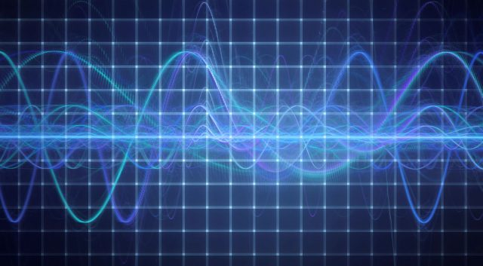
Why does this work?
Ultrasonic waves are higher than what a human ear can pick up
However, cell phone microphones can pick-up such high frequencies
Notes:
Why does this work?
-Well us humans can’t pick up such high frequencies
-The picture on the slide demonstrates a ultrasonic wave
-What is most interesting, cell phone microphones can pick-up such frequencies
-The voice assistant can not tell the difference!

Slide 5
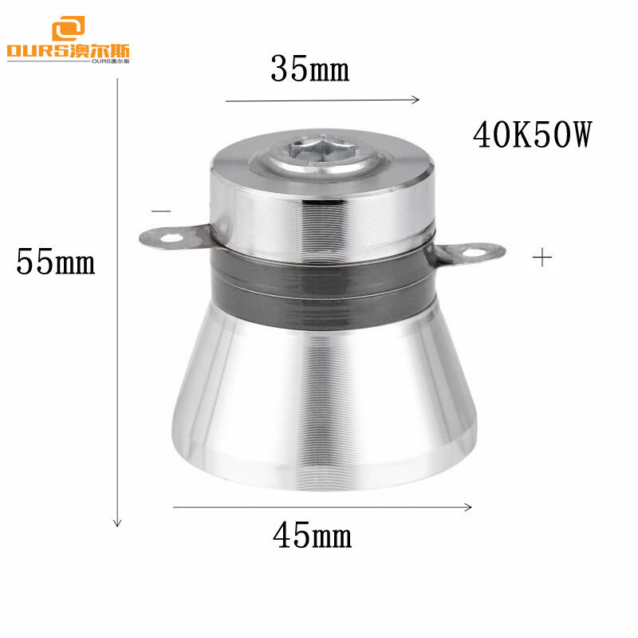
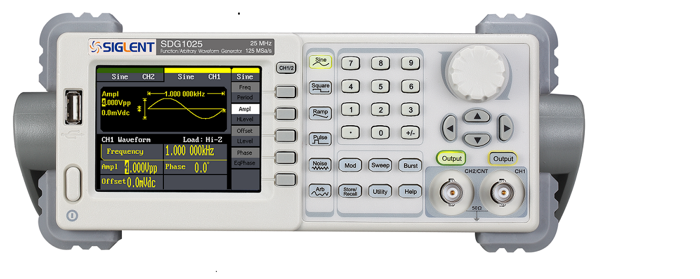
Piezoelectric Transducer
What tools do we need?
This hack requires 4 relatively cheap devices:
Piezoelectric Transducer (PZT)
Microphone
Waveform Generator
Laptop with software
Waveform Generator
Source: digitalultrasonicgenerator.com ; https://www.elektor.com/siglent-sdg1032x-arbitrary-waveform-generator-30-mhz
Notes:
What tools did the researchers use to carry out such attacks
Unlike most attacks, specialized equipment and knowledge are needed
This includes a PZT planted under the victim’s table
The picture on the top left shows how small a PZT device is
The second device, below the PZT picture, is a waveform generator
This specialized tool costs approx. $300 and it’s used to send waveform signals to the PZT
A microphone is also placed by the PZT to pickup the phones response
Of course the commands are preprogrammed using a laptop containing specialized open source software

Slide 6
How does this work? Part 1
The Piezoelectric Transducer (PZT) and Microphone are planted under the victim’s table
The hackers use the waveform generator to send an electric signal to the PZT via a hidden wire or wirelessly
The PZT converts the waveform signal to ultrasonic vibrations through the table to the phone
An under the table microphone is used to pickup Google Assistant or Siri’s response
The hacker can be up to 30 feet away from the table to be able to convert the commands into a waveform signal
Notes:
Therefore, if we look at how this done, we can see it’s a quite complicated process
The PZT and microphone must be planted near the victim
The hackers send their pre-programmed signals via the waveform generator and a specialized program that converts sounds to something the waveform can understand
The PZT converts the waveforms into ultrasonic vibrations through the table
The hidden microphone picks up the response
The hackers can be up to 30 feet away

Slide 7
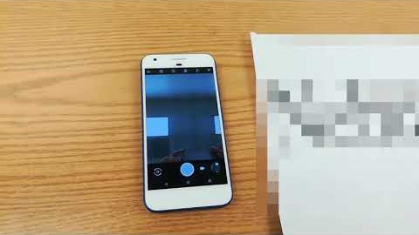
How does this work?
Part 2
SurfingAttack: a new way to hack Siri and Google Assistant with ultrasonic waves VIDEO BY THE AUTHOR
The victim phone’s microphone pick-up the ultrasonic frequency
Siri and Google Assistant often can not tell the difference
The hackers can change the victim’s settings through Siri or Google Assistant
They are also able to generate and receive messages, phone calls
They also can access data from the voice assistant
https://www.youtube.com/watch?v=pQw2zRAqVnI
Notes:
6) The victim’s phone respond to the ultrasonic waves just like someone giving voice commands
7) The hackers are usually able to change the settings of the phone
8) They can generate and receive messages, phone calls, and access data

Slide 8
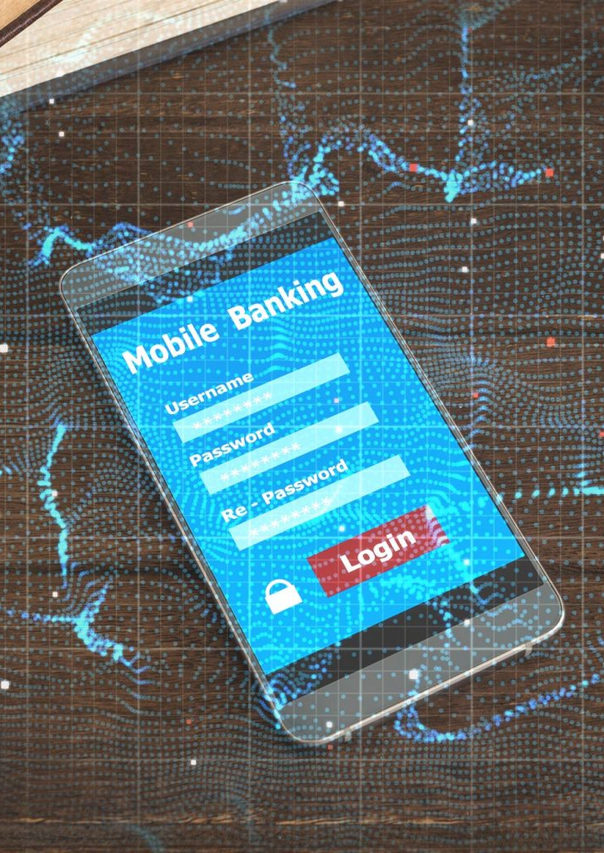
What phones does this work on?
In this study the attack worked on:
Apple iPhone – Siri
Samsung Galaxy – Google Assistant
Motorola Moto – Google Assistant
https://scitechdaily.com/surfing-attack-new-way-to-hack-siri-google-assistant-with-ultrasonic-waves/
Notes:
These are some of the devices the hack works on

Slide 9

What surfaces does this work on?
The researchers changed the material of the table to see if the table type played a factor
Surfing attack worked on wood, glass, and metal tables
Plastic tables work, but not all the time
Notes:
The surface does not matter, except for plastic.
Plastic table does not work 100% of the time

Slide 10

Why does this matter?
How many times have a banking, financial, or other sensitive webpage/application have used a text message code for two-factor authentication?
The researchers sent a mock banking authentication code to the victim’s phone to demonstrate how hackers could potentially get past two-factor authentication
In this study, the researchers where able to check the victim’s text messages
They where also able to make a fraudulent call through Siri and Google Assistant
Notes:
How many times have you used your phone for 2 factor authentication via a code sent through a text message?
The researchers demonstrated by using a mock banking authentication code sent to the victim’s phone number
The researchers where able to hear Siri and Google respond with the code using the command “read my messages”
They further had the ability to make fraudulent calls on speaker

Slide 11
MOST IMPORTANT OF ALL!
They demonstrated that this attack can work on all phones placed on the surface!
Phone case, wet table, other objects, or obstructions do not matter!
The attack can be carried out on multiple devices simultaneously!
Notes:
Most important of all, this attack works on all phones placed on the table
It did not matter if the victim had a case or if there where any obstructions on the table
They have the ability to carry out this attack simultaneously on all devices at once
This attack bypassed the voice recognition system all together

Slide 12
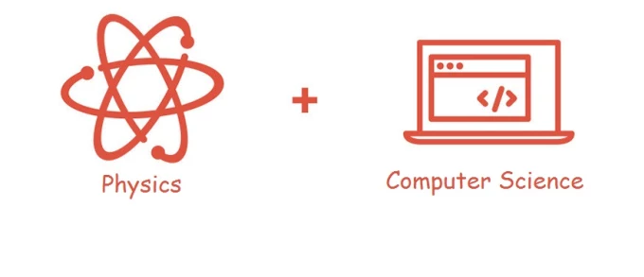
Why should IT Professionals care?
Often physics is overlooked in Cyber Security
It demonstrates the need to examine all aspects of a hardware or software during development stages
Flaw in the design of modern smartphones?
“I feel like not enough attention is being given to the physics of our computing systems”
--Ning Zhang, assistant professor of computer science and engineering at the McKelvey School of Engineering. Credit: Washington University in St. Louis (Link in notes)
Notes:
https://www.fiverr.com/saadjameel1992/solve-physics-and-computer-science-problems
https://scitechdaily.com/surfing-attack-new-way-to-hack-siri-google-assistant-with-ultrasonic-waves/
Physics is often overlooked in cyber security and hardware development
Is this a flaw in the design of modern smartphones?
The researcher had a great quote → “I feel like not enough attention is being given to the physics of our computing systems” --Ning Zhang, assistant professor of computer science and engineering at the McKelvey School of Engineering. Credit: Washington University in St. Louis (Link in notes)

Slide 13
How can we protect against this attack?
The Researchers suggested that the microphone could be relocated within the body of the phone to dampen ultrasonic frequency.
Software can be developed to distinguish between real noise and ultrasonic frequency
Easiest approach: Keep your cell phone within your pocket and place restrictions on what your voice assistant can gain access too!
Notes:
How can we protect against this attack
Phone makers can relocate the microphone within the body to dampen ultrasonic waves
They can also develop a software to distinguish between real human noise and ultrasonic machine sounds
However, the easiest approach is to keep your cellphone in your pocket and place restriction on the data your voice assistant can gain access to

Slide 14

Source:
Washington University in St. Louis. (2020, February 27). 'Surfing attack’ hacks Siri, Google with ultrasonic waves: Researchers use ultrasound waves vibrating through tables to access cellphones. ScienceDaily. Retrieved March 22, 2020 from www.sciencedaily.com/releases/2020/02/20 0227143752.htm
Notes:
See: https://www.sciencedaily.com/releases/2020/02/200227143752.htm
Overall, we can see that it is important for us to take every possible thing into consideration when designing a device or cellphone
In CPR101, our focus is on hardware, thus this flaw is something we must know, understand, and take into consideration as future programmers
I particularly enjoyed this article because I love reading about different cyber security.
I never thought we can use physics to hack a device
Hope you enjoyed this interesting presentation.

